Slide 1
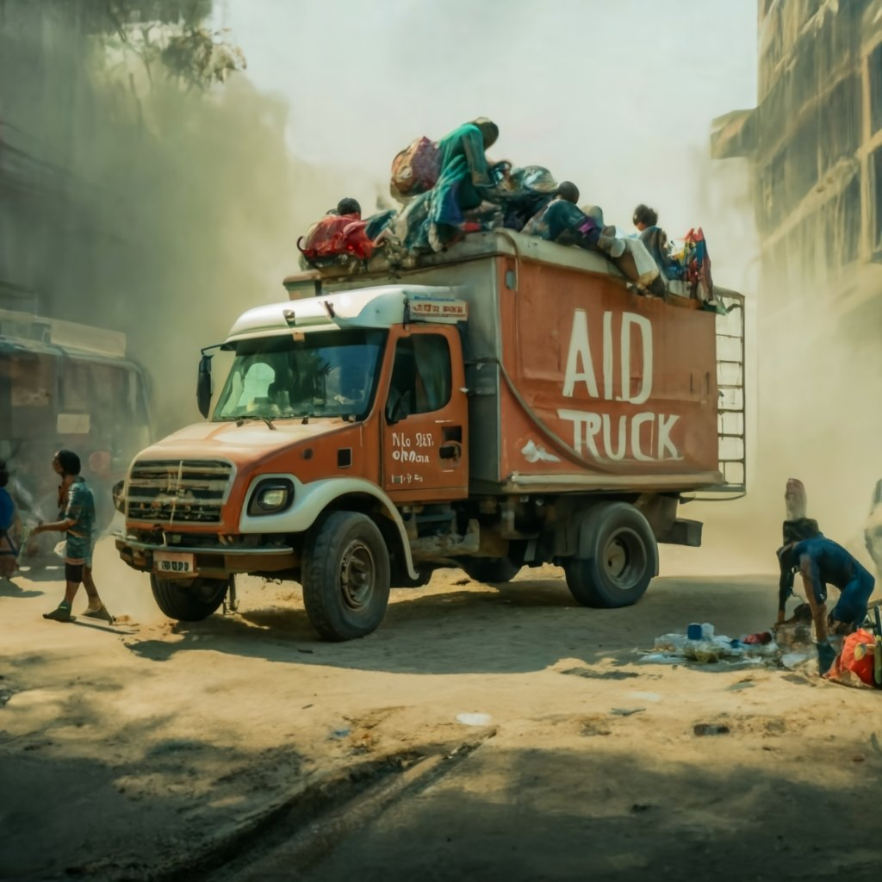
Refuge Assistance System in Gaza.

Slide 2

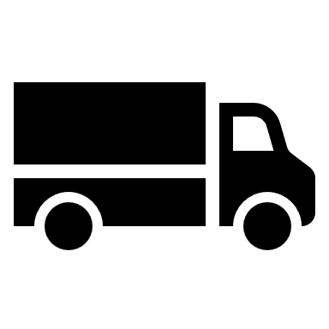
Student Name: Waed Rabee Sammar Student Number: 202210654.
Student Name: Hala Mohammad Al-Omari.
Student Number: 202210189.

Slide 3

Introduction:
“al-salam alikom warhama alleh waberkateh”.
First, mercy for the martyrs, healing for the wounded, and relief for our brave prisoners.
In this project, we wanted to talk about the refugee assistance system in Gaza. In this project, we would like to link what is happening in Palestine, specifically in Gaza, to programming. So that e-learning does not keep us away from our cause or occupy our time away from it. We want to show that anyone can support and talk about our cause in their own field and in their own way and to show that programming has to do with reality and that it is not just code.

Slide 4
Why Data Structure?
The applications are becoming more
complex and the amount of data is
increasing day by day, and this may cause
damage or loss of information, so the use
of data structure is useful in arranging
and organizing it in professional ways so
that it can be accessed quickly .

Slide 5
How do we use Data Structure in our project?
We use many different Data
Structure in different places
according to the situation that suits it
for example we use ArrayList , Queue
and Stack. We use it to store the
Data in specified methods

Slide 6
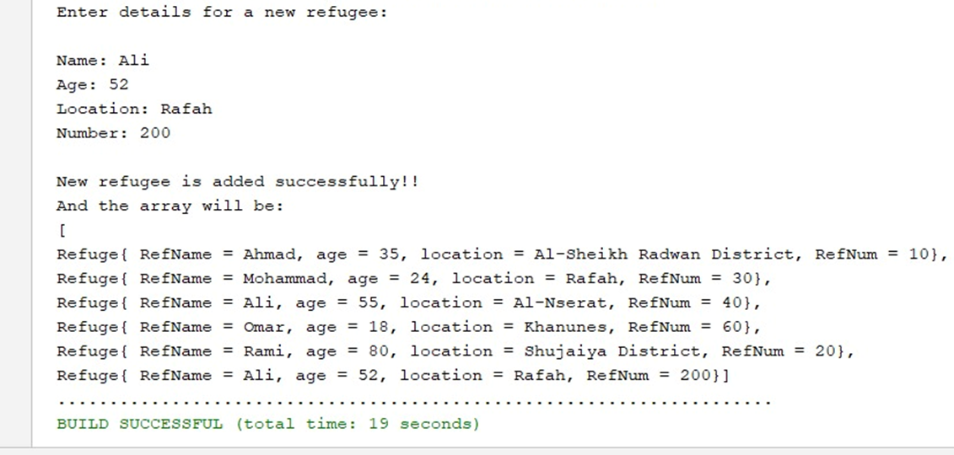
Let’s start with the Main class:
In this class we made first an Objects to each class and store it in ArrayLists.
In this class we made several methods Let’s talk about it:
AddRefuge method: This method receive ArrayList from Refuge Object,
And make user enter new information about
refugees Like: Name, Age, Location and
Number.

Slide 7
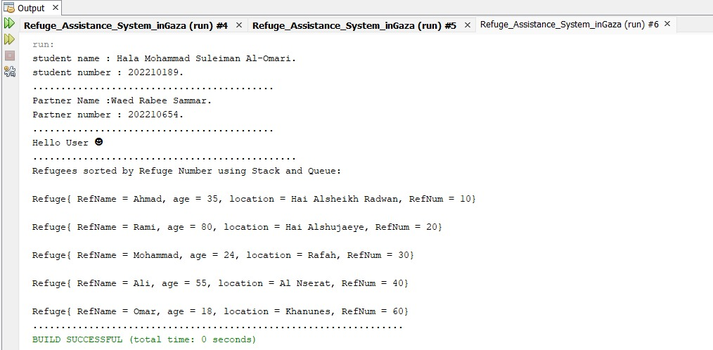
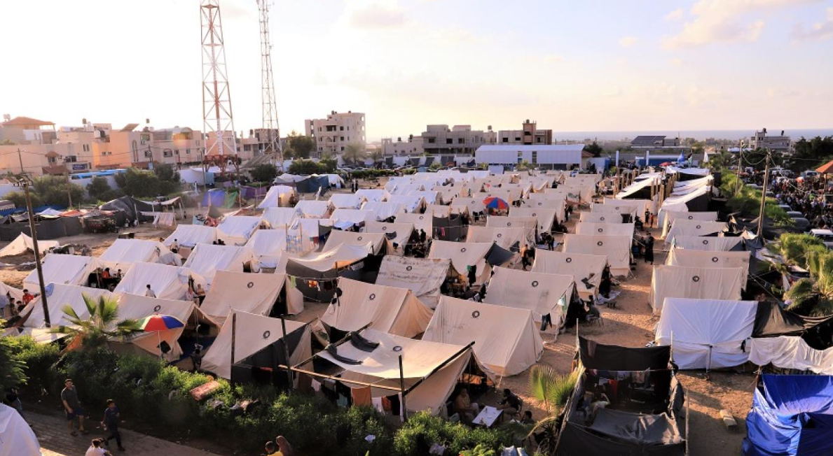
sortRefugeesByRefNum Method: This method
receive ArrayList from Refugees Object and
sort the information according the
Number of refugees.

Slide 8
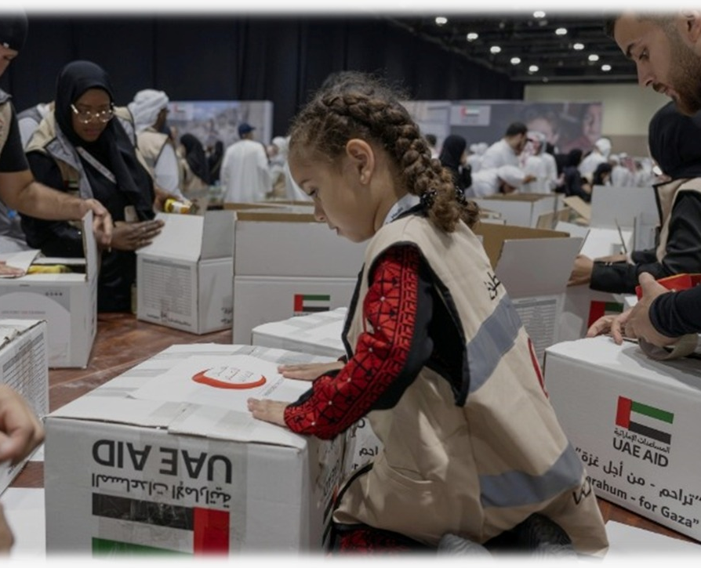
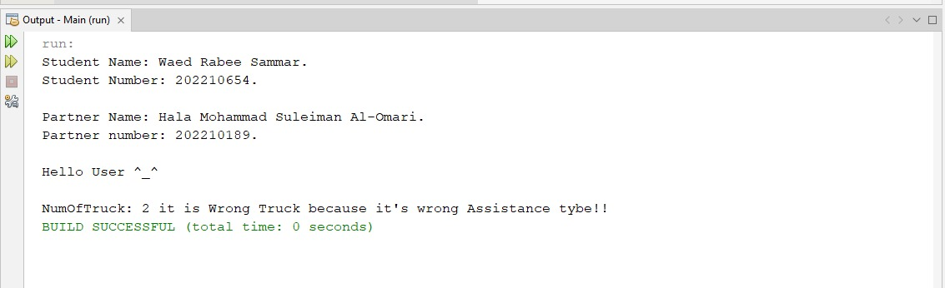
CheckAssistanceType: The
method make check of the
assistance type is allowed to
access Gaza or not

Slide 9
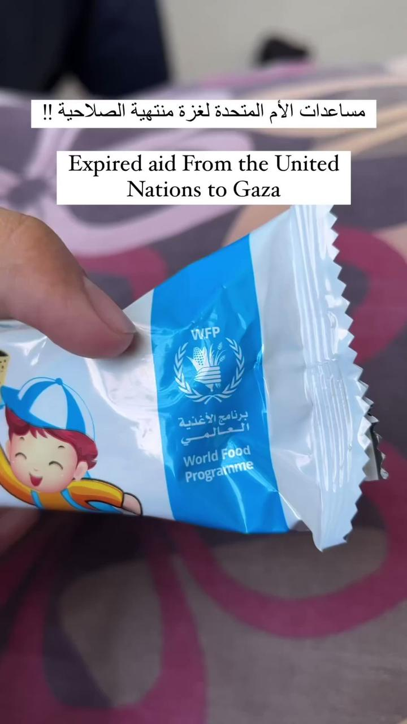
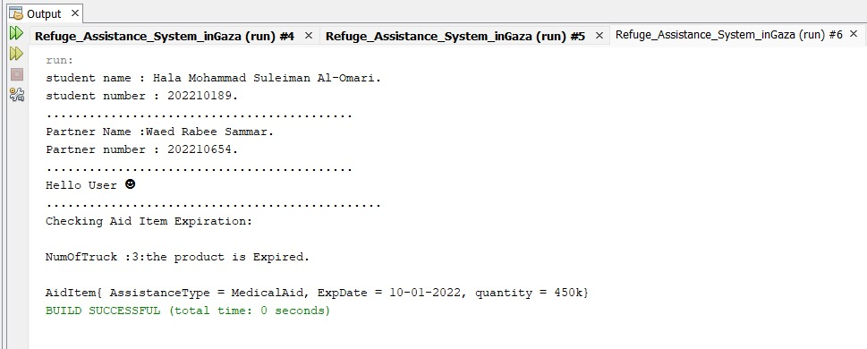
checkAidItemExpiration Method: This method receive ArrayList from AidItem object the method make check of the assistance expiration date if it is over or not for the current information.

Slide 10
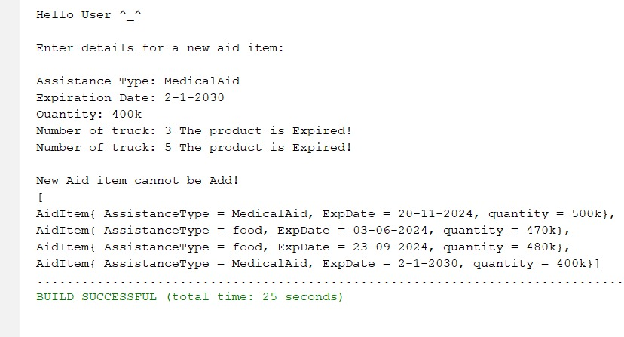
AddAidItem Method: This method receive ArrayList from AidItem Object, and make user enter new information about the Substances entering like: Assistance type, Expiration date and quantity of it. After the user enter information the method make check of the assistance type is allowed to access Gaza or not and check the expiration date.

Slide 11
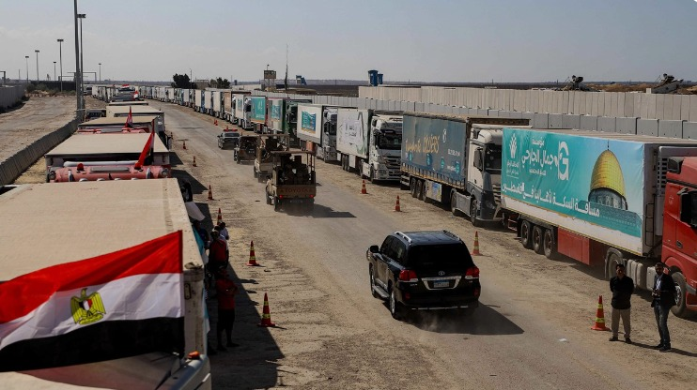
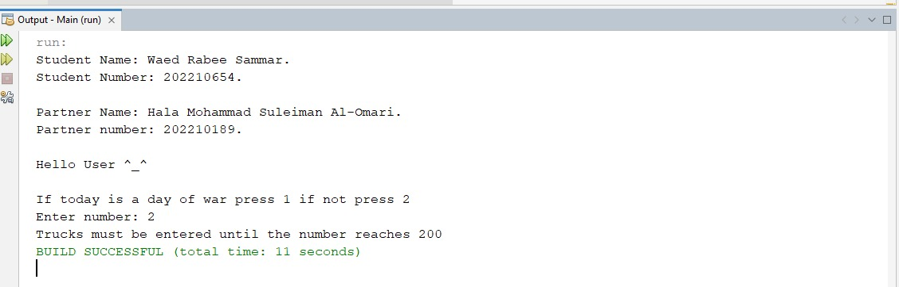
checkTheNumberOfTruck Method: This Method receive ArrayList from Truck Object and make check for the number of truck that allows to enter Gaza for a day, the method request from user to select if this day is the war day or not.

Slide 12
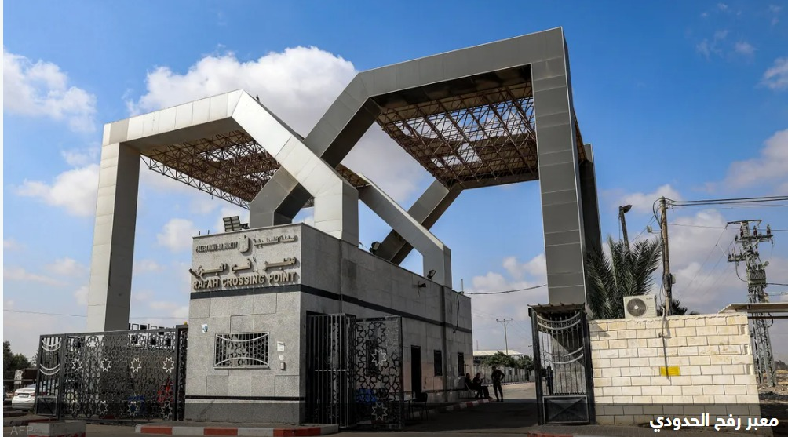
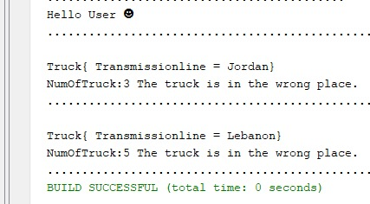
CheckTransmissionline method: This method check the path that should the truck take which is Al-Auja Crossing to the Israeli Nitzana Crossing to the Egyptian Rafah Crossing and then handed over to UNRWA and the Palestinian Red Crescent.

Slide 13
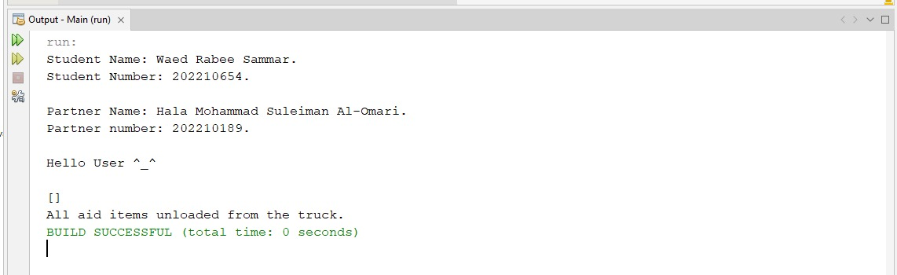
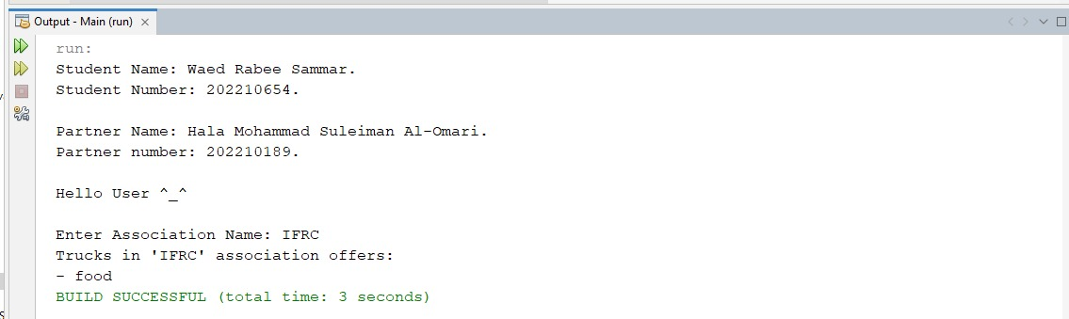
unloadAllAidItemsFromTruck method: This method receive an ArrayList of Truck and delete all information in this ArrayList.
displayTrucksForAssociation method: This method make the user enter the Association name and the method print what the assistance type this Association provide.

Slide 14
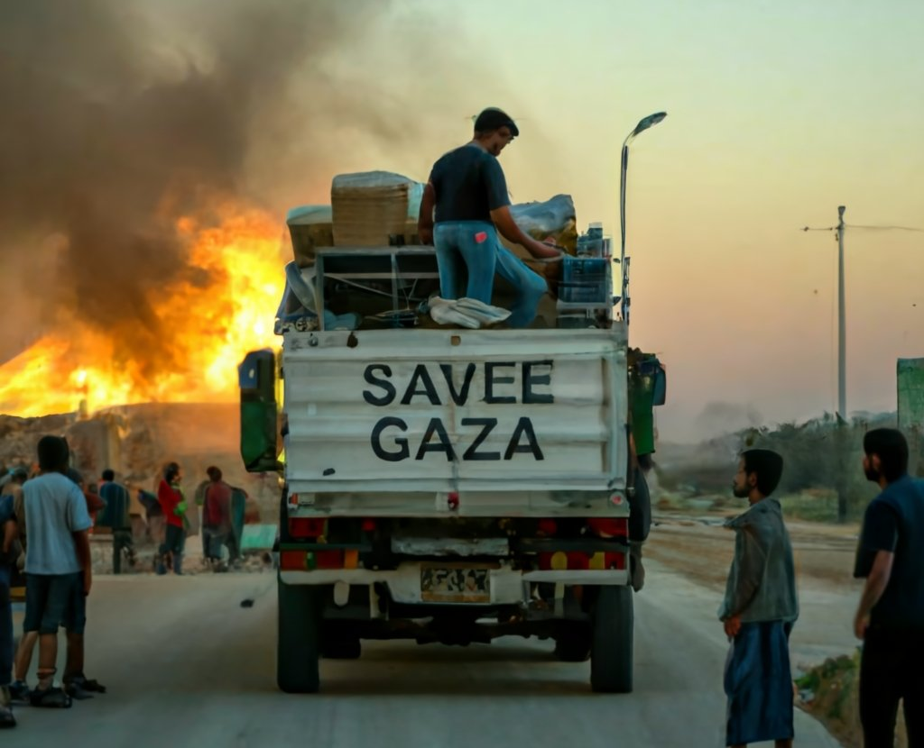
Thank You!
Made By:
Waed Rabee Sammar.
Hala Mohammad Al-Omari.

